Slide 1
Chapter 17
How to work with a database

Slide 2
Applied objectives
Use SQLite Manager to test SQL statements against a SQLite database.
Develop Python programs that use SQLite databases to store the data of the programs.

Slide 3
Knowledge objectives
Describe the organization of a relational database in terms of tables, rows, columns, primary keys, and foreign keys.
Describe a one-to-many relationship between two tables.
Describe the way the columns in a table are defined in terms of data types, null values, default values, primary keys, and foreign keys.
Describe the use of these SQL statements: SELECT, INSERT, UPDATE, and DELETE.
Describe the use of these clauses in SQL statements: FROM, WHERE, ORDER BY, and JOIN.
Describe a result set.
Describe the use of these methods of a cursor object: execute(), fetchone(), and fetchall().
Describe the use of the commit() method of a connection object.
In general terms, explain how to handle database exceptions.

Slide 4
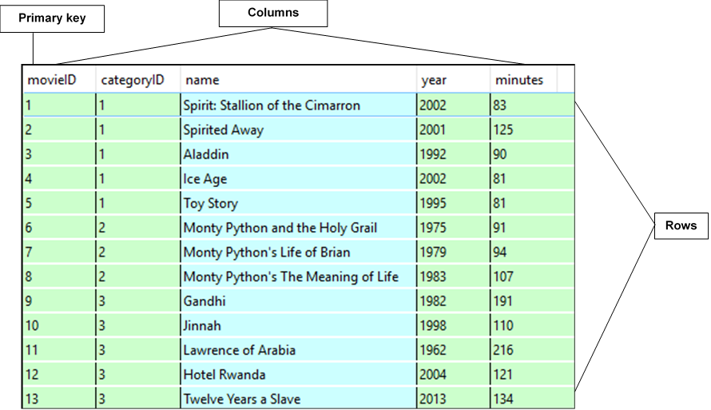
The Movie table

Slide 5
How a database table is organized
A relational database consists of tables. Tables consist of rows and columns, which can also be referred to as records and fields.
A table is typically modeled after a real-world entity, such as a product or customer, but it can also be modeled after an abstract concept, such as the data for a game.
A column represents an attribute of the entity, such as a movie’s name.
A row contains a set of values for one instance of the entity, such as one movie.
Most tables have a primary key that uniquely identifies each row in the table.
The primary key is usually a single column, but it can also consist of two or more columns.

Slide 6
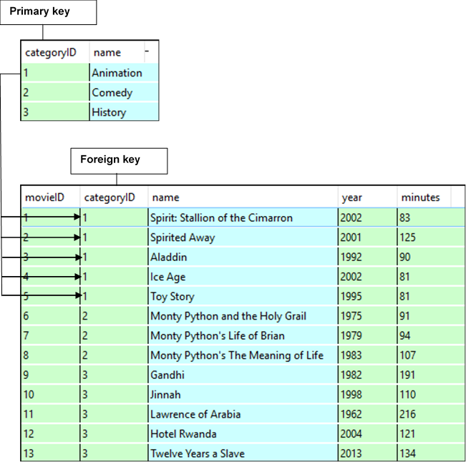
The relationship between two tables

Slide 7
How the tables in a relational database are related
The tables in a relational database are related to each other through their key columns. For example, the Category and Movie tables in this figure use the categoryID column to create the relationship between the two tables.
The categoryID column in the Movie table is called a foreign key because it identifies a related row in the Category table. A table may contain one or more foreign keys.
When you define a foreign key, you can’t add rows to the table with the foreign key unless there’s a matching primary key in the related table.
The relationships between the tables in a database correspond to the relationships between the entities they represent. The most common type of relationship is a one-to-many relationship as illustrated by the Category and Movie tables.
A table can also have a one-to-one relationship or a many-to-many relationship with another table.

Slide 8
The columns of the Category table
Data Not Default Primary Foreign
Name Type Null? Value Key? Key?
categoryID INTEGER Y NULL N N
name TEXT Y NULL N N

Slide 9
The columns of the Movie table
Data Not Default Primary Foreign
Name Type Null? Value Key? Key?
movieID INTEGER Y NULL Y N
categoryID INTEGER Y NULL N Y
name TEXT Y NULL N N
year INTEGER Y NULL N N
minutes INTEGER Y NULL N N

Slide 10
Common SQLite data types
TEXT
INTEGER
REAL
BLOB

Slide 11
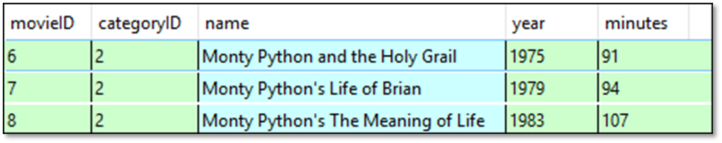
The syntax for a SELECT statement that gets all columns
SELECT * FROM table [WHERE selection-criteria] [ORDER BY col-1 [ASC|DESC] [, col-2 [ASC|DESC] ...]]
A SELECT statement that gets all columns
SELECT * FROM Movie
WHERE categoryID = 2

Slide 12
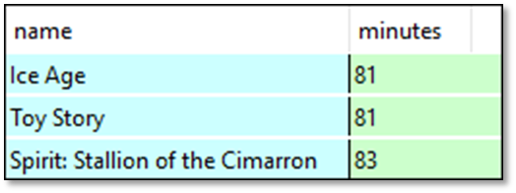
The syntax for a SELECT statement that gets selected columns
SELECT column-1[, column-2] ... FROM table [WHERE selection-criteria] [ORDER BY column-1 [ASC|DESC][, column-2 [ASC|DESC] ...]]
A SELECT statement that gets selected columns and rows
SELECT name, minutes FROM Movie WHERE minutes < 90
ORDER BY minutes ASC

Slide 13
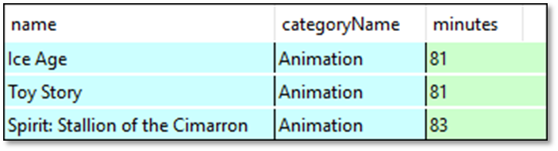
The syntax for a SELECT statement that joins two tables
SELECT col-1 [AS alias-1] [[, col-2] [AS alias-2]]... FROM table-1 [INNER ]JOIN table-2 ON table-1.col-1 = table-2.col-2
A statement that gets data from two related tables
SELECT Movie.name, Category.name AS categoryName, minutes
FROM Movie
JOIN Category
ON Category.categoryID = Movie.categoryID
WHERE minutes < 90
ORDER BY minutes ASC

Slide 14
The syntax for the INSERT statement
INSERT INTO table-name [(column-list)] VALUES (value-list)
A statement that uses a column list to add one row
INSERT INTO Movie (name, year, minutes, categoryID)
VALUES ('Juno', 2007, 96, 2)
A statement that doesn’t use a column list to add one row
INSERT INTO Movie
VALUES (14, 2, 'Juno', 2007, 96)

Slide 15
The syntax for the UPDATE statement
UPDATE table-name SET expression-1 [, expression-2] ... WHERE selection-criteria
A statement that updates a column in one row
UPDATE Movie SET minutes = 84 WHERE movieID = 4

Slide 16
The syntax for the DELETE statement
DELETE FROM table-name
WHERE selection-criteria
A statement that deletes one row from a table
DELETE FROM Movie
WHERE movieID = 14
A statement that deletes multiple rows from a table
DELETE FROM Movie
WHERE year = 1979

Slide 17
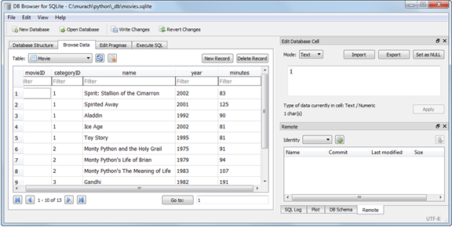
The Browse Data tab of DB Browser for SQLite

Slide 18
How to open a database using DB Browser
Start DB Browser for SQLite.
Click the Open Database button or choose the File→Open Database command. Then, use the dialog box to select the SQLite database you want to open. The database for this chapter is located here:
\murach\python\_db\movies.sqlite
This displays the tree structure of the database in the Database Structure tab.
How to view a table
Click the Browse Data tab.
Use the drop-down Tables list to select the table that you want to view.
To sort the table by the values in a column, click on the column name.

Slide 19
How to edit a table using DB Browser
To edit the data in the rows, change the data in the table.
To add or delete rows, use the New Record or Delete Record button.
To save the changes, click the Write Changes button.
To cancel the changes, click the Revert Changes button.
How to execute a SQL statement
Click the Execute SQL tab.
Enter the SQL statement.
Click the Execute SQL button.

Slide 20
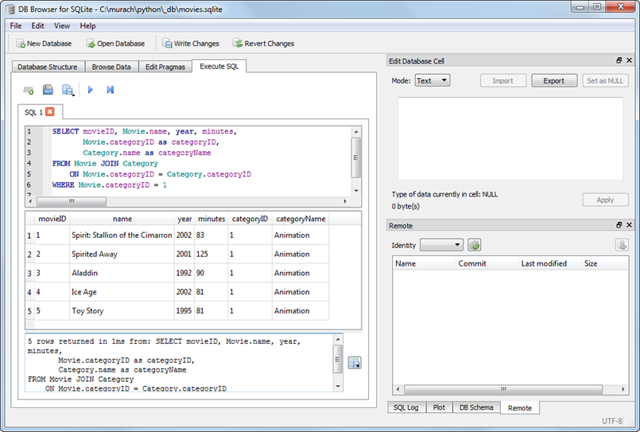
The Execute SQL tab after a SQL statement has been executed

Slide 21
How to import the SQLite module
import sqlite3
The syntax for connecting to a database
conn = sqlite3.connect(path_to_database_file)
How to connect to a db in the working directory
conn = sqlite3.connect("movies.sqlite")
How to connect to a db not in the working directory
import sys
import os
if sys.platform == "win32": # Windows
DB_FILE = "/murach/python/_db/movies.sqlite"
else: # Mac OS X and Linux
HOME = os.environ["HOME"]
DB_FILE = HOME + "/Documents/murach/python/_db/movies.sqlite"
conn = sqlite3.connect(DB_FILE)

Slide 22
How to close a connection object
if conn:
conn.close()

Slide 23
The cursor() method of the connection object
cursor()
The execute() method of the cursor object
execute(sql [params_tuple])

Slide 24
How to get a cursor from the connection object
c = conn.cursor()
How to execute a SELECT statement…
…that doesn’t have parameters
query = '''SELECT * FROM Movie'''
c.execute(query)
…that has a parameter
query = '''SELECT * FROM Movie
WHERE minutes < ?'''
c.execute(query, (90,))

Slide 25
How to automatically close the cursor object
The code for importing the closing() function
from contextlib import closing
The syntax for automatically closing the cursor object
with closing(resource) as name:
statements
How to automatically close the cursor object
with closing(conn.cursor()) as c:
query = '''SELECT * FROM Movie'''
c.execute(query)

Slide 26
The fetchone() and fetchall() methods of the cursor object
fetchone()
fetchall()

Slide 27
How to use the fetchone() method to get a row
with closing(conn.cursor()) as c:
query = '''SELECT * FROM Movie
WHERE movieID = ?'''
c.execute(query, (5,)
movie = c.fetchone()

Slide 28
How to access columns by index
print("Name: " + movie[2])
print("Year: " + str(movie[3]))
print("Minutes: " + str(movie[4]))
How to access columns by name
How to enable column access by name
conn.row_factory = sqlite3.Row # Row is a constant
How to access columns by name
print("Name: " + movie["name"])
print("Year: " + str(movie["year"]))
print("Minutes: " + str(movie["minutes"]))

Slide 29
How to use the fetchall() method to get all rows
with closing(conn.cursor()) as c:
query = '''SELECT * FROM Movie
WHERE minutes < ?'''
c.execute(query, (90,))
movies = c.fetchall()
How to loop through all rows
for movie in movies:
print(movie["name"], "|", movie["year"], "|",
movie["minutes"])
The console
Spirit: Stallion of the Cimarron | 2002 | 83
Ice Age | 2002 | 81
Toy Story | 1995 | 81

Slide 30
The commit() method of the connection object
commit()

Slide 31
How to execute an INSERT statement
name = "Juno"
year = 2007
minutes = 96
categoryID = 2
with closing(conn.cursor()) as c:
sql = '''INSERT INTO Movie
(name, year, minutes, categoryID)
VALUES
(?, ?, ?, ?)'''
c.execute(sql, (name, year, minutes, categoryID))
conn.commit()

Slide 32
How to execute an UPDATE statement
id = 4
minutes = 84
with closing(conn.cursor()) as c:
sql = '''UPDATE Movie
SET minutes = ?
WHERE movieID = ?'''
c.execute(sql, (minutes, id))
conn.commit()

Slide 33
How to execute a DELETE statement
id = 12
with closing(conn.cursor()) as c:
sql = '''DELETE FROM Movie
WHERE movieID = ?'''
c.execute(query, (id,))
conn.commit()

Slide 34
Code that tests the database (part 1)
# import the sqlite module and closing function
import sqlite3
from contextlib import closing
# connect to the database and set the row factory
conn = sqlite3.connect("movies.sqlite")
conn.row_factory = sqlite3.Row
# execute a SELECT statement - with exception handling
try:
with closing(conn.cursor()) as c:
query = '''SELECT * FROM Movie
WHERE minutes < ?'''
c.execute(query, (90,))
movies = c.fetchall()
except sqlite3.OperationalError as e:
print("Error reading database -", e)
movies = None

Slide 35
Code that tests the database (part 2)
# display the results
if movies != None:
for movie in movies:
print(movie["name"], "|", movie["year"], "|",
movie["minutes"])
print()
# execute an INSERT statement
name = "A Fish Called Wanda"
year = 1988
minutes = 108
categoryID = 1
with closing(conn.cursor()) as c:
sql = '''INSERT INTO Movie
(name, year, minutes, categoryID)
VALUES
(?, ?, ?, ?)'''
c.execute(sql, (name, year, minutes, categoryID))
conn.commit()
print(name, "inserted.")

Slide 36
Code that tests the database (part 3)
# execute a DELETE statement
with closing(conn.cursor()) as c:
sql = '''DELETE FROM Movie
WHERE name = ?'''
c.execute(sql, (name,))
conn.commit()
print(name, "deleted.")
The console
Spirit: Stallion of the Cimarron | 2002 | 83
Ice Age | 2002 | 81
Toy Story | 1995 | 81
A Fish Called Wanda inserted.
A Fish Called Wanda deleted.

Slide 37
User interface for the Movie List program (part 1)
The Movie List program
COMMAND MENU
cat - View movies by category
year - View movies by year
add - Add a movie
del - Delete a movie
exit - Exit program
CATEGORIES
1. Animation
2. Comedy
3. History
Command: add
Name: The Lion King
Year: 1994
Minutes: 89
Category ID: 1
The Lion King was added to database.

Slide 38
User interface for the Movie List program (part 2)
Command: cat
Category ID: 1
MOVIES - ANIMATION
ID Name Year Mins Category
----------------------------------------------------------------
1 Spirit: Stallion of the Cimarron 2002 83 Animation
2 Spirited Away 2001 125 Animation
3 Aladdin 1992 90 Animation
4 Ice Age 2002 81 Animation
5 Toy Story 1995 81 Animation
14 The Lion King 1994 89 Animation
Command: exit
Bye!

Slide 39
The objects module for the business tier
class Movie:
def __init__(self, id=0, name=None, year=0,
minutes=0, category=None):
self.id = id
self.name = name
self.year = year
self.minutes = minutes
self.category = category
class Category:
def __init__(self, id=0, name=None):
self.id = id
self.name = name

Slide 40
The db module for the database tier (part 1)
import sys
import os
import sqlite3
from contextlib import closing
from objects import Category
from objects import Movie
conn = None
def connect():
global conn
if not conn:
if sys.platform == "win32":
DB_FILE = "/murach/python/_db/movies.sqlite"
else:
HOME = os.environ["HOME"]
DB_FILE = HOME +
"/Documents/murach/python/_db/movies.sqlite"
conn = sqlite3.connect(DB_FILE)
conn.row_factory = sqlite3.Row

Slide 41
The db module for the database tier (part 2)
def close():
if conn:
conn.close()
def make_category(row):
return Category(row["categoryID"], row["categoryName"])
def make_movie(row):
return Movie(row["movieID"], row["name"], row["year"],
row["minutes"], make_category(row))
def get_categories():
query = '''SELECT categoryID, name as categoryName
FROM Category'''
with closing(conn.cursor()) as c:
c.execute(query)
results = c.fetchall()
categories = []
for row in results:
categories.append(make_category(row))
return categories

Slide 42
The db module for the database tier (part 3)
def get_category(category_id):
query = '''SELECT categoryID, name AS categoryName
FROM Category WHERE categoryID = ?'''
with closing(conn.cursor()) as c:
c.execute(query, (category_id,))
row = c.fetchone()
category = make_category(row)
return category
def get_movies_by_category(category_id):
query = '''SELECT movieID, Movie.name, year, minutes,
Movie.categoryID as categoryID,
Category.name as categoryName
FROM Movie JOIN Category
ON Movie.categoryID = Category.categoryID
WHERE Movie.categoryID = ?'''
with closing(conn.cursor()) as c:
c.execute(query, (category_id,))
results = c.fetchall()

Slide 43
The db module for the database tier (part 4)
movies = []
for row in results:
movies.append(make_movie(row))
return movies
def get_movies_by_year(year):
query = '''SELECT movieID, Movie.name, year, minutes,
Movie.categoryID as categoryID,
Category.name as categoryName
FROM Movie JOIN Category
ON Movie.categoryID = Category.categoryID
WHERE year = ?'''
with closing(conn.cursor()) as c:
c.execute(query, (year,))
results = c.fetchall()
movies = []
for row in results:
movies.append(make_movie(row))
return movies

Slide 44
The db module for the database tier (part 5)
def add_movie(movie):
sql = '''INSERT INTO Movie (categoryID, name, year, minutes)
VALUES (?, ?, ?, ?)'''
with closing(conn.cursor()) as c:
c.execute(sql, (movie.category.id, movie.name,
movie.year, movie.minutes))
conn.commit()
def delete_movie(movie_id):
sql = '''DELETE FROM Movie WHERE movieID = ?'''
with closing(conn.cursor()) as c:
c.execute(sql, (movie_id,))
conn.commit()

Slide 45
The ui module for the presentation tier (part 1)
#!/usr/bin/env/python3
import db
from objects import Movie
def display_title():
print("The Movie List program")
print()
display_menu()
def display_menu():
print("COMMAND MENU")
print("cat - View movies by category")
print("year - View movies by year")
print("add - Add a movie")
print("del - Delete a movie")
print("exit - Exit program")
print()

Slide 46
The ui module for the presentation tier (part 2)
def display_categories():
print("CATEGORIES")
categories = db.get_categories()
for category in categories:
print(str(category.id) + ". " + category.name)
print()
def display_movies(movies, title_term):
print("MOVIES - " + title_term)
line_format = "{:3s} {:37s} {:6s} {:5s} {:10s}"
print(line_format.format("ID", "Name", "Year", "Mins",
"Category"))
print("-" * 64)
for movie in movies:
print(line_format.format(str(movie.id), movie.name,
str(movie.year),
str(movie.minutes),
movie.category.name))
print()

Slide 47
The ui module for the presentation tier (part 3)
def display_movies_by_category():
category_id = int(input("Category ID: "))
category = db.get_category(category_id)
if category == None:
print("There is no category with that ID.\n")
else:
print()
movies = db.get_movies_by_category(category_id)
display_movies(movies, category.name.upper())
def display_movies_by_year():
year = int(input("Year: "))
print()
movies = db.get_movies_by_year(year)
display_movies(movies, str(year))

Slide 48
The ui module for the presentation tier (part 4)
def add_movie():
name = input("Name: ")
year = int(input("Year: "))
minutes = int(input("Minutes: "))
category_id = int(input("Category ID: "))
category = db.get_category(category_id)
if category == None:
print("There is no category with that ID. " +
"Movie NOT added.\n")
else:
movie = Movie(name=name, year=year, minutes=minutes,
category=category)
db.add_movie(movie)
print(name + " was added to database.\n")
def delete_movie():
movie_id = int(input("Movie ID: "))
db.delete_movie(movie_id)
print("Movie ID " + str(movie_id) +
" was deleted from database.\n")

Slide 49
The ui module for the presentation tier (part 5)
def main():
db.connect()
display_title()
display_categories()
while True:
command = input("Command: ")
if command == "cat":
display_movies_by_category()
elif command == "year":
display_movies_by_year()
elif command == "add":
add_movie()
elif command == "del":
delete_movie()
elif command == "exit":
break
else:
print("Not a valid command. Please try again.\n")
display_menu()
db.close()
print("Bye!")
if __name__ == "__main__":
main()

